Slide 1
Module 18

Slide 2
HEART - PUMPING ORGAN
Pressure in artery during ventricular contraction
When the blood flows through the blood vessels, it exerts force on the wall of the blood vessels.
This pressure is greater in the arteries than the veins.
Heart beat has two phases
is called as
SYSTOLIC PRESSURE
SYSTOLE
CONTRACTION
120 mm Hg
DIASTOLE
Sphygmomanometer
RELAXATION
80 mm Hg
is called as
Unit to measure blood pressure
DIASTOLIC PRESSURE
Pressure in artery during ventricular relaxation
Blood pressure is measured by an instrument called as

Slide 3
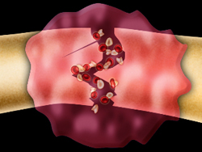
A system to repair the damage from time to time if it is damaged
Repair of the damaged network
The Platelets
A type of blood cell

Slide 4
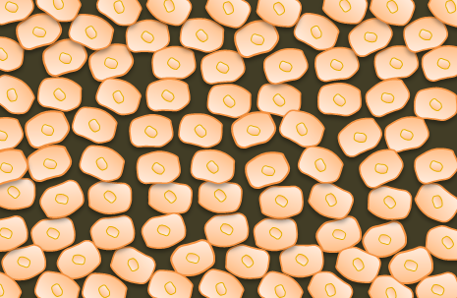
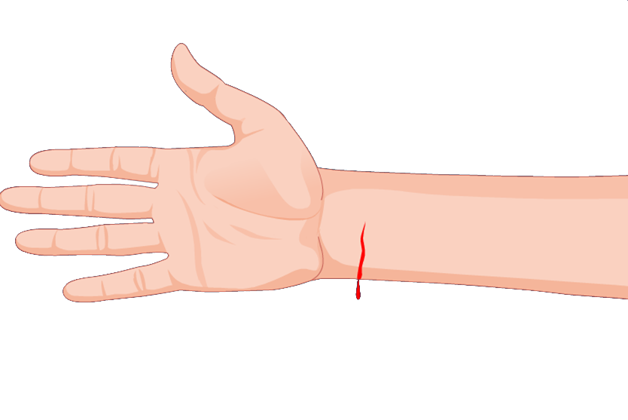
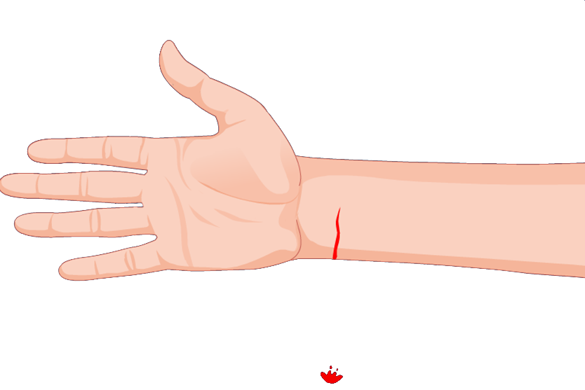
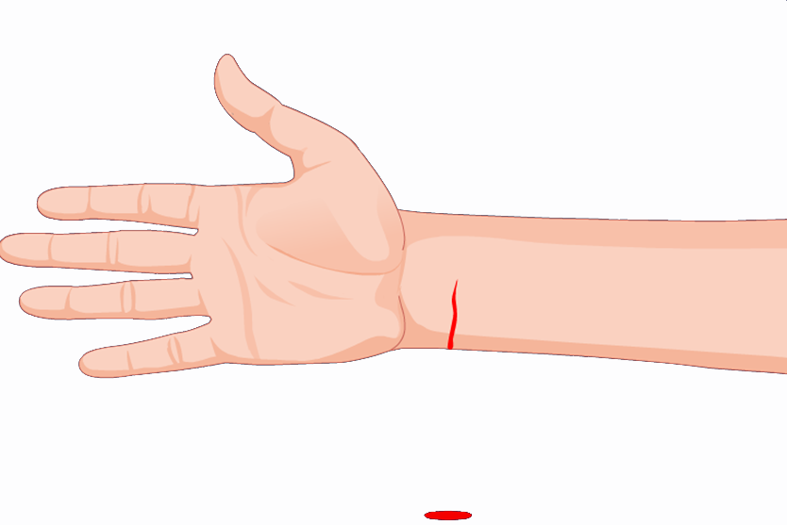
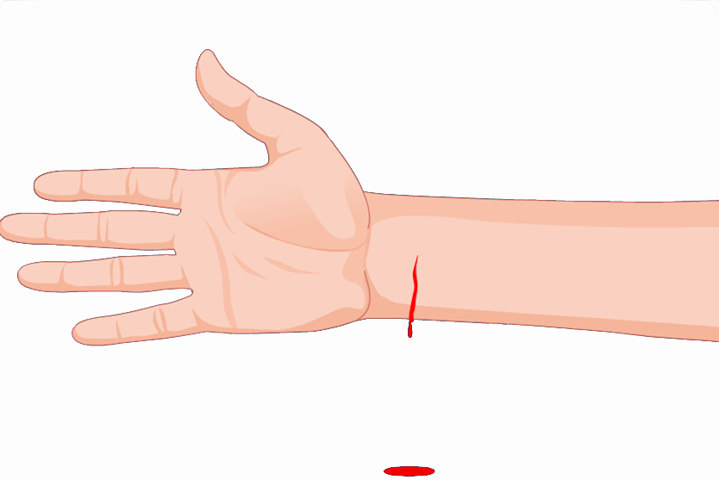
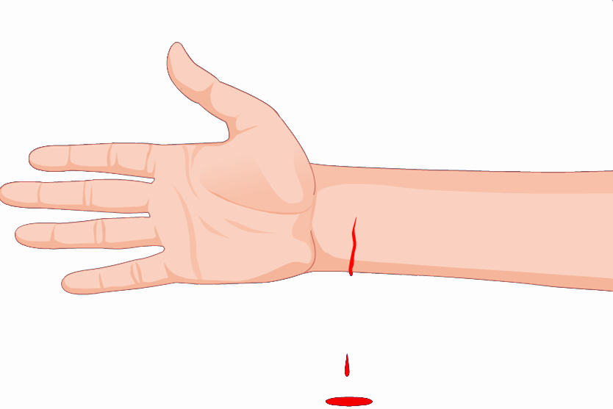
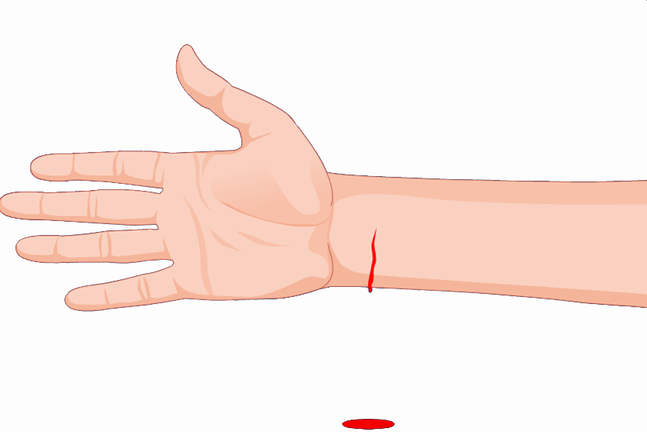







A cut damages the network of blood vessels causes leakage in a closed system.
This would leads to loss of blood and loss of pressure.
This reduces the efficiency of the pumping system.
So the blood platelets do the work of plugging these leaks by clotting the blood at the point of injury.

Slide 5
Thank You

